Slide 1
The drive for coherent global information standards
Howard Mason
BAE Systems
Office of the CIO

Slide 2

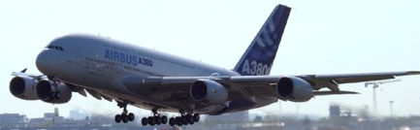
Extended Enterprise
Virtual Enterprise
Supply Chain
→ Customer
  A/C Manfacturer
    Main Assembly (e.g. Engine)
      requires Sub-Assembly (e.g. Actuator)
        requires Sub-Sub-Assembly (e.g. Pump)
Interoperability: a critical factor for the Aerospace and Defence Industry
requires Parts (e.g. Cable)
  requires Parts Details (e.g. Connector)
    requires Raw Material

Slide 3

Data Explosion Through The Life Cycle
Data Explosion Through The Life Cycle
Support/Services
- Products & spares
- Configuration
- ILS (Repair, maintenance)
- Heath Usage
- Logistics
- Tech Docs
Design
- Products (PDM)
- Configuration
- Specification
Manufacturing
/ Supply Chain
Solutions
Feedback / Problems
As needed > as designed > as manufactured > as delivered > as maintained
Concept
Design
M/f
Service
Operation
Disposal
Retire
Product Lifecycle Management (Industrial approach for end to end process
Design activities (incl. series and mods)
Manufacturing (incl. series and mods)
Support / ILS
Req. Eng. System
MRO / Service Sys
PDM Sys
ERP Sys
------ ENTERPRISE DATA – REUSE --------

Slide 4
Data Explosion Through The Life Cycle
What problems are you seeing with data through the life cycle?
  Technical? People? Culture? Change management…?
Can you easily transfer data between yourself, your customers and your suppliers?
  If not, why not?
Is data from design re-used automatically through the life cycle?
Do you get effective feedback from the operation of your product?
Do you have multiple versions of the same information?
  Is the information different in the different locations?
What can be done to help?
  How can we help the supply network to be more interoperable, secure and cost effective?

Slide 5

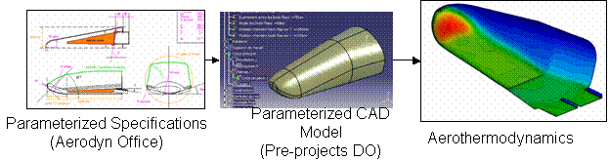
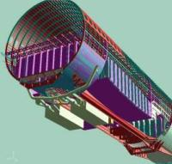
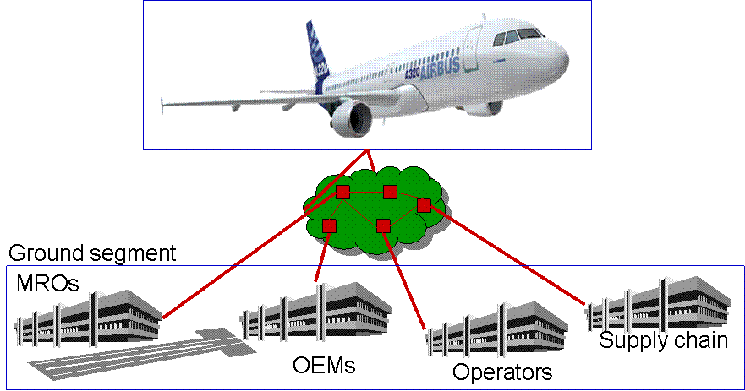
Some Aerospace & Defence challenges (2020)
Concept Development
Design, manufacture & Assembly
Validation & Certification
Operations
“Full virtual rigs” deployed with Testing Labs and Certification authorities
“Full virtual concept” deployed with System contractors and with Disciplines
“Full 3D configured DMU” deployed with component and sub-assembly Suppliers
“Full virtual A/C enabled services” deployed with Operators and MROs
How to organise collaboration around these paradigms?
How to reach collaboration industrial performance?
Effective Interoperability solutions
Standards!

Slide 6
Why?
A standard is:
A documented agreement
Among an identified population
Containing technical specifications or other criteria
To be used as rules, guidelines or definitions of characteristics
To ensure that materials, products, processes and services are fit for purpose

Slide 7
Benefits of information agreements
Customer
  Common interface from multiple suppliers
  Interoperation across products
Supply network
  Single interface to multiple customers
Tool vendor
  Bigger market for same software
  Improved reliability
Interoperability
Common understanding of meaning
Protection of information against changes in IT over time

Slide 8
High Level Framework
Business Applications
(Company Specific)
“Information Backbone”
Business scenarios
Company
Security
Contractual
Regulatory
Processes
Data
Registry
Repository
Business
Partner
IT Services
AIA Guidelines
Technical Environment
(Framework is product & company agnostic)
Key Components for Building Interoperability
Notes:
Interoperability between firewalls can be broken down into a number of key components which all need to be addressed.
The solutions need to be independent of company-specific applications and technical environments
This also applies to agile internal enterprise architectures

Slide 9
Component Framework
Service assembly
Business scenarios
Conformance and interoperability testing
Registry/Repository
for Discovery, Presence, Availability
Security
Constraints
Contractual and regulatory
Semantics - Terminology
Process models
Data
Assembly
Information content/components
Classification schemes
Component libraries
Enterprise data and metadata
Reference data
Identifiers
Process definition mechanisms
Information definition mechanisms
Service definition mechanisms
Representation options
Transport options
Networks
Physical representation
Guidelines (Design, Build, Operate)
Notes:
Need to show complete landscape for interoperable eBusiness
Assessment of initiatives
Guidance for deploying solutions
Must support cross-sectoral coherence
Opportunity for multiple levels of detail
Needs to be recognisable from IT viewpoint
Based on industry best practice
Developed based on NIST eBSC and international MoU/MG work
Builds on many other models
Scenarios can be used to identify process and data requirements, underlying IT and other operational constraints

Slide 10
Delivering Business Solutions
Composed of
Which Enable
Scenarios
Scenarios form the basis for defining solutions
Definition Process
Process
Constrained by
Data
Contract &
Regulatory
Delivered by
Security
IT Services
Design Guidelines
Implementation Guidelines
Operational Guidelines
Notes:
Process 1

Slide 11
Who needs to agree?
International
Regional
National
Sectoral
Company
Project
Scope of agreement
Aerospace and defence is a global sector
Ease of agreement

Slide 12
JISCOT – Driving the standards we need
Looking at the processes we need to support
Identifying the key standards
Designating Industry and MoD leads
  Supporting UK groups
Tracking the development of key standards
Addressing key issues for the UK
Engaging with the developers
  Monitoring
  Participating where necessary
Publicising the strategy and deliverables
Regular telecons to address issues

Slide 13
ASD Radar screen
d
Track
OAGIS 9
RFID
App Stds
PLCS
DEXs
Available
external
standards
KBL
Monitor
external
development
SysML
STEP
AP233
TSCP
STEP
STEP
AP210
SAML
Supplier
UID
STEP
AP212
Candidate
STEP
AP235
ISO 8000
STEP
AP209
ISO 22745
BPMN
STEP
AP203
TSCP
IdFv1
ebXML
STEP
AP214
Adopted
XPDL
SCORM
STEP
AP239
3D
Visualisation
TSCP
SEv1
SPEC2000
JT
STEP
ASD S-Series
TSCP
3D visualisation
LOTAR
S2000M
STE100
S3000L
S1000D
Boost
Aero
SX000i
S5000F
TDP
message
EN9300-1xx
STEP
AP 242
S4000M
ASD
development
S9000D
EN9300-2xx
Participate in
external
development
yy
Blip available
EN9300
LOTAR
yy
Blip in preparation
Current ASD SSG actions
Last revised: 2012-09-10

Slide 14
Current AIA/ASD collaboration
LOTAR – Long Term Archiving and Retrieval
  Planning for long term preservation
  Geometry
  Product structure
  Dimensioning, tolerances and other manufacturing information
Integrated Logistics Specifications
  STE100 – Simplified Technical English
  S1000D – Technical Publications with A4A
  S2000M – Material Management
  S3000L – Logistics Support Analysis (for adoption this year)
  S4000M – Development of Scheduled Maintenance Planning
  S5000F – Operational and Maintenance Data Feedback
  S6000T – Training (under development)
  S9000D – Dictionary (under development)
  SX000i – ILS Handbook (under development)
TSCP – Transglobal Secure Collaboration Program(me)
  Secure Email v.1 and v.2
  Identity Federation

Slide 15
Identified challenges
New STEP standard for 3D product models
  With automotive industry – making reasonable progress
Transactional standards and the impact of the new BoostAeroSpace hub
  conflict with Exostar, OAGIS, and UN specifications
REACH-IT – data gathering for chemical registration
  Rolling data up the supply chain
3D visualisation
  multiple standards
Relationship to A4A – Airlines for America – was ATA
  Input to ASD indicates that A4A is not open to adoption of AIA/ASD S-series standards
Data quality – extending ISO 8000 for product data
Open Technical Dictionary/Codification champion
Resources to maintain UK participation
  AIA/ASD S-series work
  ISO committees

Slide 16
Building the solution
Business scenarios
Process
Data
Contract &
Regulatory
Security
IT Services
Analysis
Recommended solution components
(0,1,….)
Design Guidelines
RP
RP
RP
RP
RP
Implementation Guidelines
Implementation
Testing
Integrated pilot testing
Operational Guidelines
RP
Recommended practice

Slide 17

Process to build Technology Roadmaps links bottom-up technology needs to future market requirements
Grow
Technology
Maintain
Business Pyramid
Fix or Exit
New Markets / Market Needs
Customer Benefits / Requirements
Technology Needs List
New NSR A/C
Border Security
Restoring security in case of crisis
Understanding our planet (land surface, ocean, …)
Global Monitoring for Environment & Security
Understand the universe and the Solar system
…
Technical properties :
Light weight,
High Lift/Low drag,
Adaptability
Customer satisfaction :
Airline : Low cost maintenance, ,environment, Maturity / Reliability
Pilot : pilot workload
Passenger : Comfort, In Flight Entertainment
…
illustrative
Virtual design
Engineering product processes
Sensor systems
Image processing
….
For new market / product lines
Strategic Technology Objective/Strategic Technology Program*
Current Position towards competition/market needs
Target Position
Action Plan
Growth markets
(what market will bring revenues in 5 to 15 years ?)
Key product, function,
system,
subsystem, component and processes
identified for future growth
Technical
capability
Techno 1
Techno 2
Techno 3
1
3
2

Slide 18
TRL roadmap of priority actions for a strategic technology/capability (example)
A350 XWB
A50X
A50X Plan B
Future Capabilities
TRL Level
EIS A350
MG3 A50X
MG5 A50X
MG7 A50X
9
8
7
6
Techno Component yy
Standard Component xx
5
4
S234
3
illustrative
2
C236
1
S123
S567
2009
2010
2011
2012
2013
2014
2015
2016
2017
2018
2019
2020

Slide 19
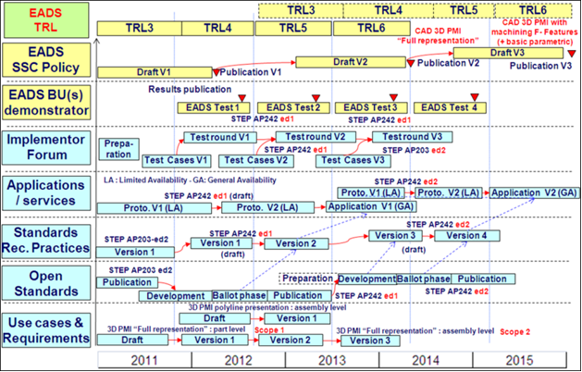
5 Years vision for CAD 3D PMI
Interoperability Roadmap
Full set of activities
illustrative
Interoperability solution Vn for application in XXX programme

Slide 20
Key messages
A consistent set of standards for digital interoperability is being identified, assessed, developed and implemented in answer to US and European Aerospace, Space & Defence Industry global needs
Trade associations provide the needed capability
  Prime contractors and the supply chain
  Co-ordination between US and European activities
Interoperability components are available to support the technology plan for your business

