Slide 1
Industry Specifications and their importance in
Product Lifecycle Management
(Dr Michael Day & Deborah Jane Ham)
(September-2012)

Slide 2
Industry Specifications in PLM
Agenda:
  Purpose of industry specifications.
  How specifications can be used in Product Life-Cycle Management (PLM) methodology.
  Provide an overview of Industry specifications being developed by:
    AeroSpace and Defence Industries Association of Europe (ASD).
    Aerospace Industries Association (AIA)
    Air Transport Association (ATA) (renamed Airlines for America (A4A)).
  Benefits of adopting specifications.

Slide 3
Industry Specifications in PLM
Purpose of S-Series specifications:
  Agreed world-wide land, sea and air for civil and defence applications Integrated Logistic Support requirements.
  Defines an agreed data to be standardised between:
    Multi-partners, vendors and suppliers.
    Multi-nations.
    Multi-customer environments.
  Enables definition of an agreed standardised data model.
  Enables a standardised transport methodologies to be developed.
  Being extended to cover full Product Life Cycle support.

Slide 4
Industry Specifications in PLM
How specifications can be used in PLM.
  PLM supports the equipment through its Product Life Cycle.
  S-Series specifications were originally developed for In-service support.
  The scope of the S-Series specifications is being extended to include In-service data that is valuable to improve design and reliability of a product.
  So the recommendation is for the inclusion of S-Series into PLM software to ensure comprehensive Product Life Cycle support.

Slide 5
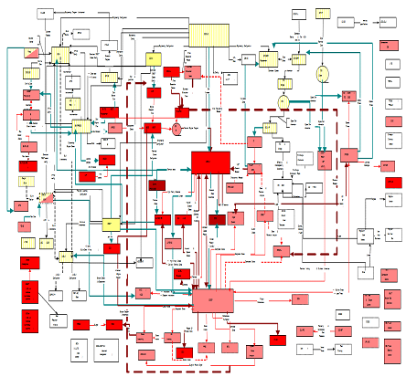
Industry Specifications in PLM
Product Life-Cycle Management practices (today).
Unit Life
System A
System B
Issues:
Bespoke and multiple data formats.
Excessive point-to-point transport mechanisms between systems.
Uncontrolled data including duplication inhibiting ‘master data management’.
High cost of implementation and extended delivery timescales.
Increased costs for system support sustainment.
Lack of integration between disciplines, eg. engineering, manufacturing, etc.
Unit Life
Unit Config
SB Action
Maint Event
System C

Slide 6
Industry Specifications in PLM
Product Life-Cycle Management practices (future).
System A
System B
Unit Life
Unit Config
Maint Event
Unit Life
SB Action
Maint Event
Unit Config
Unit Life
Unit Config
Maint Event
Unit Life
SB Action
Maint Event
Unit Config
Enterprise Service Bus
Unit Life
Unit Life
Unit Life
Unit Life
System C
Source: Rolls-Royce (proprietary)

Slide 7
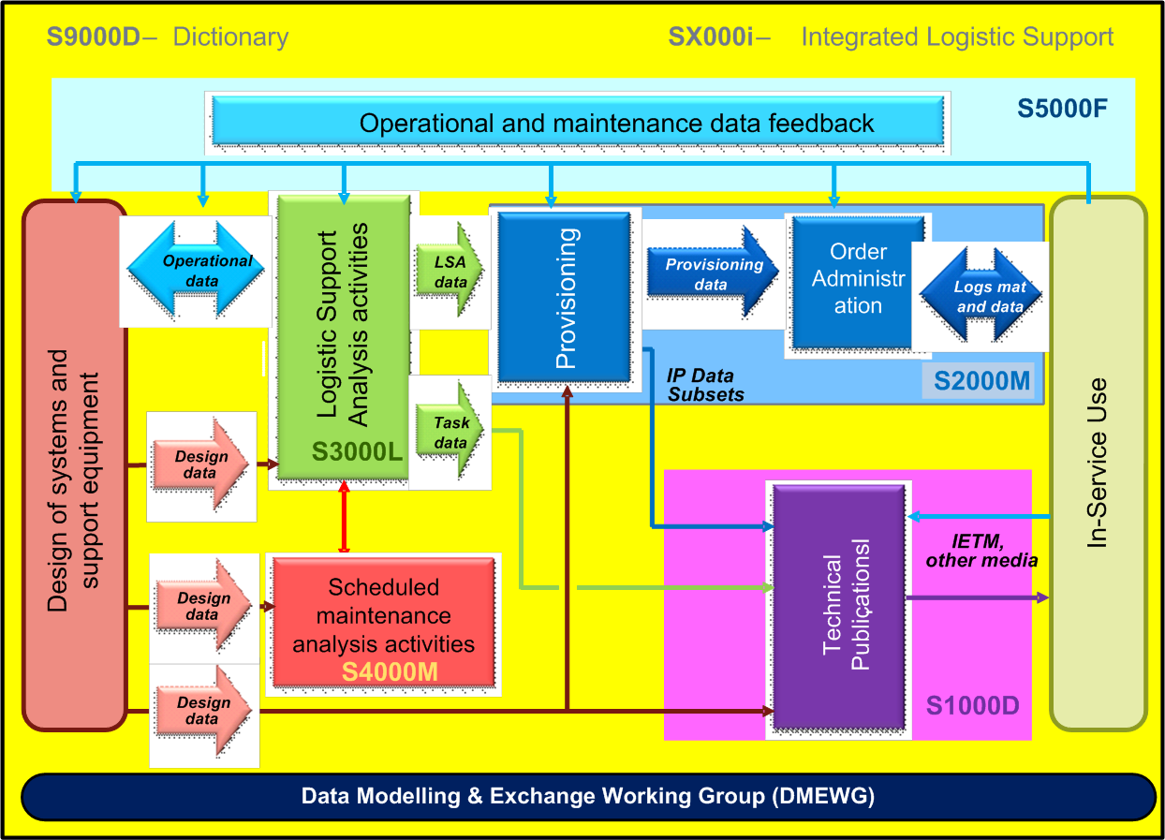
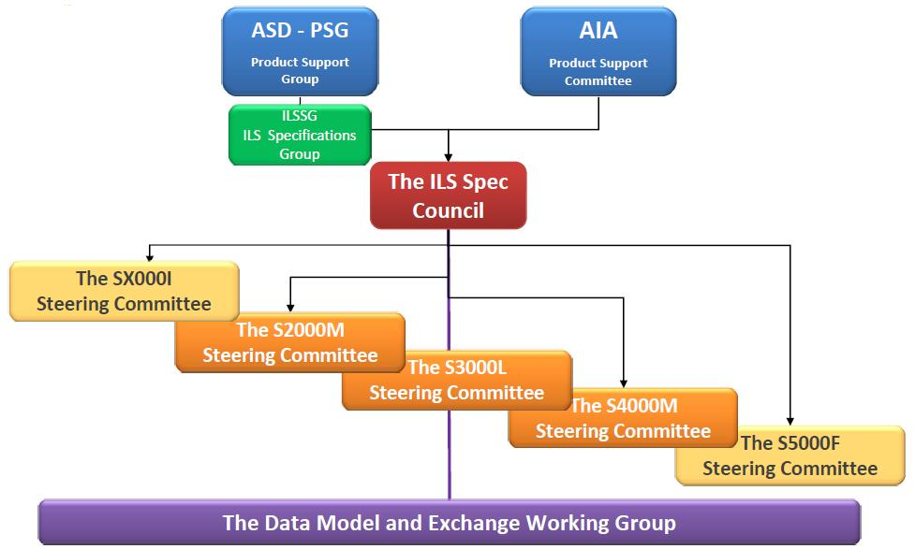
Industry Specifications in PLM
S5000F – Operational & Maintenance Feedback.
Operational (eg. lifing, serviceability, performance,...)
Maintenance, Repair & Overhaul (MRO) feedback, etc.
ASD/AIA S-Series specifications.
S3000L – Logistic Support Analysis
Development of a support system that is integrated to the product.
Contains maintainability, RAM, FMECA, LORA, MTA,...
S2000M – Provisioning & Order Administration.
Initial provisioning
Supply chain management
Order administration, etc
S1000D – Technical publications.
Task data.
Time limits.
Schedules.
Descriptions, Fault isolations, inspections, etc.
S4000M – Scheduled maintenance (MSG-3)
Optimise traditional processes
Consider new hazards & materials (composite structures)
How to cope with ecological & legal aspects, etc
DMEWG
Define data elements across S-Series suite.
Create supporting data model using PLCS.
Develop data exchanges to support S-Series, etc
Source: Cassidian (2012)
Source: Carl Wilén (SaaB– June 2011)

Slide 8
Industry Specifications in PLM
DMEWG Common Data Model
Specific UoFs and classes
for S2000M
Specific UoFs and classes
for S3000L
S-Series_CDM_001-01
S2000M-Data_ model_002-01
S3000L-Data_ model_002-03
Common UoFs and classes
Source: Rolls-Royce (2012)
Contains all the classes that are in at least one of the S-Series specifications

Slide 9
Industry Specifications in PLM
S5000F - Operational & Maintenance Feedback.
S-Series Interfaces
S1000D
S2000M
S3000L
S4000M
PLC / PLM
Research & Development.
Design.
Manufacture.
Performance.
Life Cycle Engineering.
Reliability Centered Maintenance
Etc.
Feedback types
Maintenance data
RAMCT
Maintenance analysis
Safety analysis
Integrated fleet Management
Platform health and usage
PBL Support
Life cycle cost
Warranty
Obsolescence
Product configuration
Operational data
Data Model
Data Exchanges
Product & Service
Improvement

Slide 10






Industry Specifications in PLM
Product Life-Cycle Management using S-Series.
Operational and maintenance
data feedback
DEX
Enterprise Service Bus
PRODUCT LIFECYCLE SUPPORT (PLCS)
DEX
DEX
DEX
DEX
DEX
DEX
Tech pubs
LSA/LSAR
Training needs analysis
Design of Systems & Support Equipment
Material management
RCM/MSG-3
PLM

Slide 11
Industry Specifications in PLM
Summary.
  Defined purpose of industry specifications.
  Provided an overview of Industry specifications being developed.
  Provide overview of the S-Series specifications.
  Defined how specifications can be used in Product Lifecycle Management (PLM)
  Demonstrated the benefits of participation in the S-Series development to extend beyond Integrated Logistic Support for Product Life-Cycle Management.

Slide 12
Industry Specifications in PLM
Questions ?
S-Series Roadmap

Slide 13
Industry Specifications in PLM
Additional/Support Information

Slide 14
Industry Specifications in PLM
DMEWG Data Modelling Policy
  Provides a common Data Model Governance for S-Series.
    Each Specification to have its own data modelling expert.
    Modelling will be completed in compliance with DMEWG policy.
    Common Data Elements will be defined & integrated into the Common Data Model.
  Data modelling policy:
    Data Model will be created in Universal Modelling Language (UML).
    Data Modelling compliance - DMEWG UML Writing Rules & Style Guide.
    Data Modelling Tool Enterprise Architect V9.3.
    Data model to be used to define and create a standardised data exchanges.
      Compliant to ISO 10303:AP239 Product Lifecycle Support (PLCS) standard.
  DMEWG data modelling SMEs:
    Leif Gyllström (chair of DMEWG)
    Dr Mike Day & Deborah Jane Ham (DMEWG/S5000F).

Slide 15
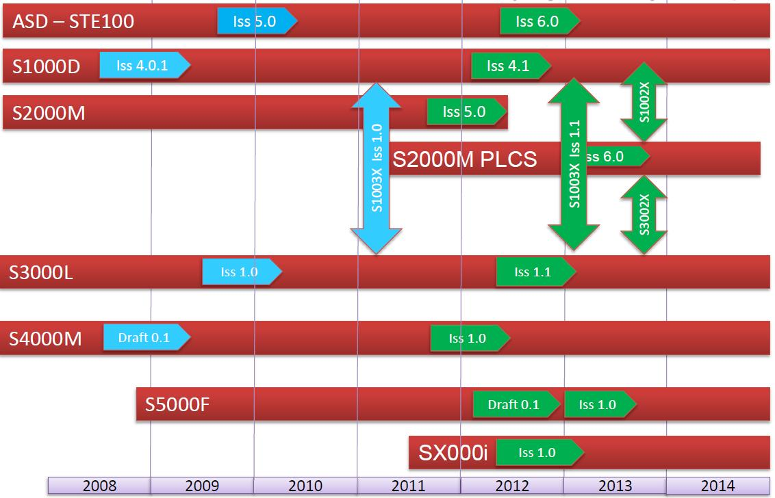
Industry Specifications in PLM
S-Series Roadmap
Source: Albert Grabmeier (ILS Chair – June 2012)

Slide 16
Industry Specifications in PLM
S-Series benefits.
  Delivers standardised through life Product Life Cycle management.
    Single solution for Product Support.
    Provides common architecture and data exchanges to support PLM and other applications.
    Standardised PLCS data model to enable common re-use/application.
    Single global Data Repository.
    Data Interoperability and integration in a global environment.
    Handbook to provide guidance
  Business benefits.
  Realises reduced costs and lead-time for PLC support delivery.
  Reduction in sustained support costs for architecture and data management due to standardisation.
  Increased efficiency and effectiveness for PLM and PLC integration.

